Slide 1
Seat Belts Have They Made a difference ?
Todd McCarley Loss Control Representative
AMIC / MWCF

Slide 2
FACTS
The # 1 leading cause of “ AT WORK DEATHS IS VEHICLE ACCIDENTS”
25% of all driving accidents are the result of excessive speed.
70% of driving accidents occur within 25 miles from home or work.
1 out of 4 employees who drive experience an accident while at work.

Slide 3
FACTS
Most people know some one who has died in a car accident.
Motor vehicles crashes cause a death every 12 minutes, and a disabling injury every 14 seconds.
Most accidents occur on clear sunny days, with good visibility.

Slide 4
FACTS
60% of crashes with deaths or injuries happen on roads with posted speed limits of 40 mph or less.
The most hazardous environment most employees face on a daily basis is the road.

Slide 5
SEATBELT MYTHS
I don’t need a seatbelt when I’m traveling at low speeds or going on short trips.
More than 80% of all motor vehicle crashes occur at speeds less than 40mph.

Slide 6
SEATBELT MYTHS
I’m uncomfortable and too confined when I wear a seatbelt.
Seatbelts are designed to allow you to reach necessary driving controls. The newer shoulder belt retractors give you even more freedom.

Slide 7
SEATBELT MYTHS
I might be saved if I’m thrown clear of a car crash.
The fact is that your chances of being killed are four times greater if you are thrown from a vehicle.

Slide 8
BOTTOM LINE
ALWAYS WEAR YOUR SEATBELT.
“IT’S THE LAW”

Slide 10
According to a research report from the NHTSA, seatbelts save approximately 13,000 lives in the US each year. The NHTSA estimates that 7,000 US car accident fatalities would have been avoided if the victims had been wearing seat belts.

Slide 11
While seatbelts do occasionally contribute to serious injury or death, nearly all safety experts agree that buckling up dramatically increases your chances of surviving an accident. According to the NHTSA, seatbelts reduce the risk of death for a front seat car occupant by about 50 percent.

Slide 12
When you think about it, this is absolutely amazing: How can a piece of fabric end up being the difference between life and death ? What does it actually do ?

Slide 13
Crashing Concepts
The basic idea of a seatbelt is very simple: It keeps you from flying through the windshield or hurdling toward the dashboard when your car comes to a abrupt stop. But why would this happen in the first place ? In short, because of Inertia.

Slide 14
What is Inertia ?
Inertia is an object’s tendency to keep moving until something else works against this motion. To put it another way, inertia is every objects resistance to changing its speed and direction of travel. Things naturally want to keep going.

Slide 15
If a car is speeding along at 50 mph, inertia wants to keep it going 50 mph in one direction. Air resistance and friction with the road are constantly slowing it down, but the engine’s power compensates for this energy loss.

Slide 16
Anything that is in the car, including the driver and passengers, has its own inertia, which is separate from the car’s inertia. The car accelerates riders to its speed. Imagine that you’re coasting at a steady 50 mph. Your speed and the car’s speed are pretty much equal, so you feel like you and the car are moving as a single unit.

Slide 17
But if the car were to crash into a telephone pole, it would be obvious that your inertia and the car’s were absolutely independent. The force of the pole would bring the car to an abrupt stop, but your speed would remain the same. Without a seatbelt, you would either slam into the steering wheel at 50 mph or go flying through the windshield at that speed.

Slide 18
Just as the pole slowed the car down, the car’s interior or the road would slow you down by exerting a tremendous amount of force. It is given that no matter what happens in a crash, something would have to exert force on you to slow you down. But depending on where and how the force is applied, you might be killed instantly or you might walk away.

Slide 20
If you hit the windshield with your head, the stopping power is concentrated on one of the most vulnerable parts of your body. It also stops you very quickly, since the glass is a hard surface. This can easily kill or severely injure a person. A seatbelt applies the stopping force to more durable parts of the body over a longer period of time.

Slide 23
A typical seatbelt consists of a lap belt, which rest over your pelvis, and a shoulder belt, which extends across your chest. The two belt sections are tightly secured to the frame of the car in order to hold passengers in their seats. When the belt is worn correctly, it will apply most of the stopping force to the rib cage and the pelvis, which are relatively sturdy parts

Slide 24
of the body. Since the belts extend across a wide section of your body, the force isn’t concentrated in a small area, so it can’t do as much damage. Additionally, the seatbelt webbing is made of more flexible material than the dashboard or windshield. It stretches a little bit, which means the stop isn’t quite so abrupt.

Slide 25
The seatbelt shouldn’t give more than a little, however, or you might bang into the steering wheel or side window. Safe seatbelts will only let you shift forward slightly.

Slide 26
Seat belts are also to be used with all equipment that provides a seatbelt and has roll over protection.

Slide 29
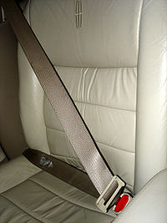

Slide 32
Crumple Zones
A cars crumple zones does the real work of softening the blow from a crash. Crumple zones are areas in the front and rear of a car that collapse relatively easily. Instead of the entire car coming to an abrupt stop when it hits an obstacle, it absorbs some of the impact force by flattening, like a soda can. The cars cabin is much sturdier, so it does not crumple around the passengers.

Slide 33
It continues moving briefly, crushing the front of the car against the obstacle. Of course, crumple zones will only protect you if you move with the cab of the car– that is, if you are secured to the seat by your seatbelt.

Slide 34
How seatbelts work
In a typical seatbelt system, the belt webbing is connected to a retractor mechanism. The central element in the retractor is a spool, which is attached to one end of the webbing. Inside the retractor, a spring applies a rotation force, or torque, to the spool. This works to rotate the spool so it winds up any loose webbing.

Slide 35
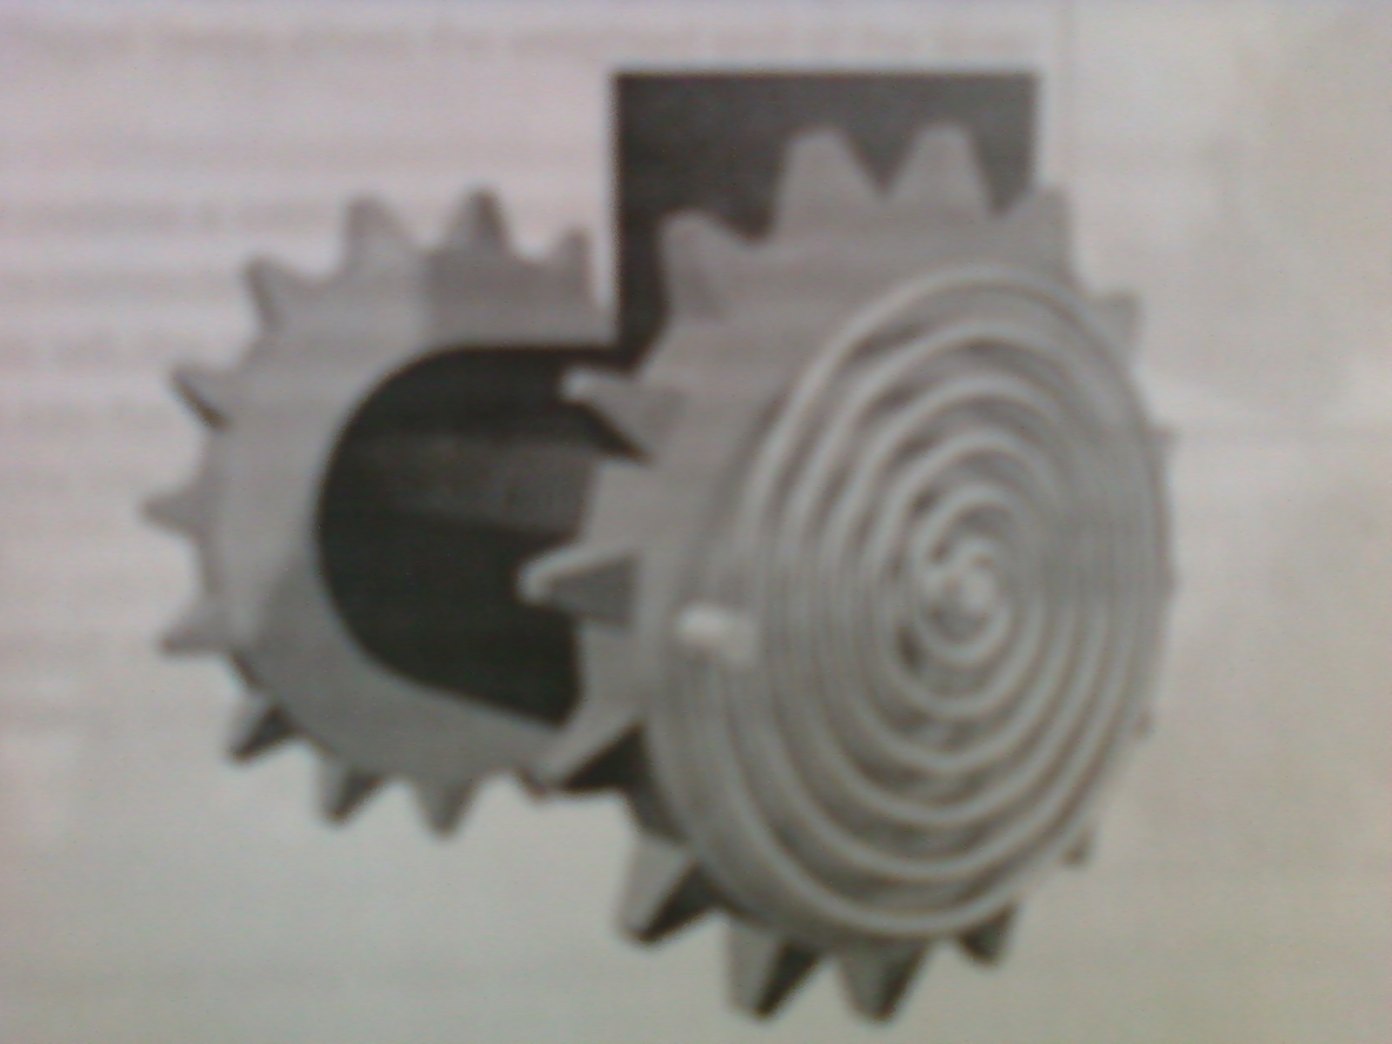

Slide 36
When you pull the webbing out, the spool rotates counter-clockwise, which turns the attached spring in the same direction. Effectively, the rotating spool works to untwist the spring. The spring wants to return to its original shape, so it resists this twisting motion. If you release the webbing, the spring will tighten up, rotating the spool clockwise until there is no more slack in the belt.

Slide 38
It might come as a surprise, but the same officers who enforce seat belt laws often times do not to wear them, and it's not hard to find evidence on the streets.
Police say they see the belts as a hindrance that slows their response time. Mike Guzy spent 21 years as a St. Louis officer, and says he refused to wear them.
"There are people who are going to run from you. There are people we've seen in a couple of recent incidents who will attack an officer," he said. "In either case you need to be able to get out of your vehicle in a relatively short period of time."

Slide 39
The St. Louis Police Department announced on Wednesday that Officer David Haynes did not have his seat belt on when he crashed during a high-speed pursuit. Officer Haynes died in that crash on March 24.
It is the second fatal crash involving a St. Louis police officer where seat belts were not in use. Police Chief Daniel Isom said that it is a constant struggle to get officers to wear the life-saving devices that citizens are required by law to wear.

Slide 40
This debate has been going on for years, but the two recent deaths have drawn greater attention to the issue. Despite a stiff penalty, the chief can't seem to convince officers to wear safety belts. "It's an issue throughout law enforcement," said Chief Isom. "It's become a bone of contention between management and officers."
Officer Haynes wasn't the only recent death. Officer Julian Moore died in October responding to a scene. There's no proof a seat belt would have saved either officer, but a recent policy imposes a one-day suspension on any officer caught not wearing a seat belt. According to the St. Louis Metropolitan Police Department, more than 50 officers were suspended since January of last year for not wearing a seat belt.

Slide 41
How do get them to wear their seat belts ?
You have a policy. It details seat belt usage and the State Law. They want their pay check every two weeks. Pretty Simple

Slide 43
QUESTIONS ?

